Slide 1
Cognizant RFI Response for Air Canada

Slide 2
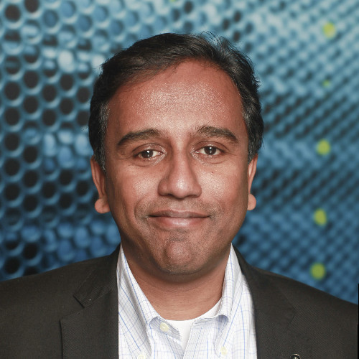
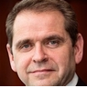

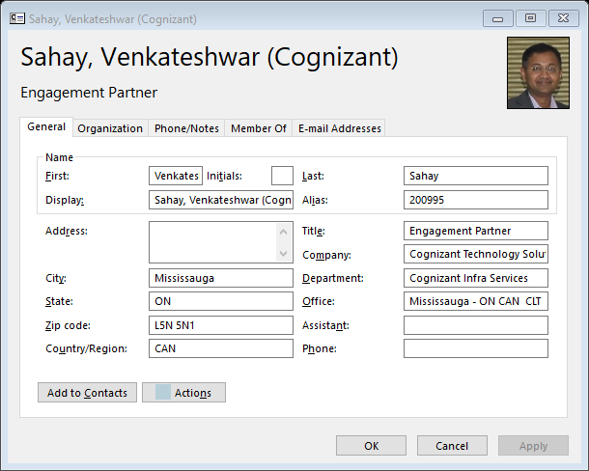
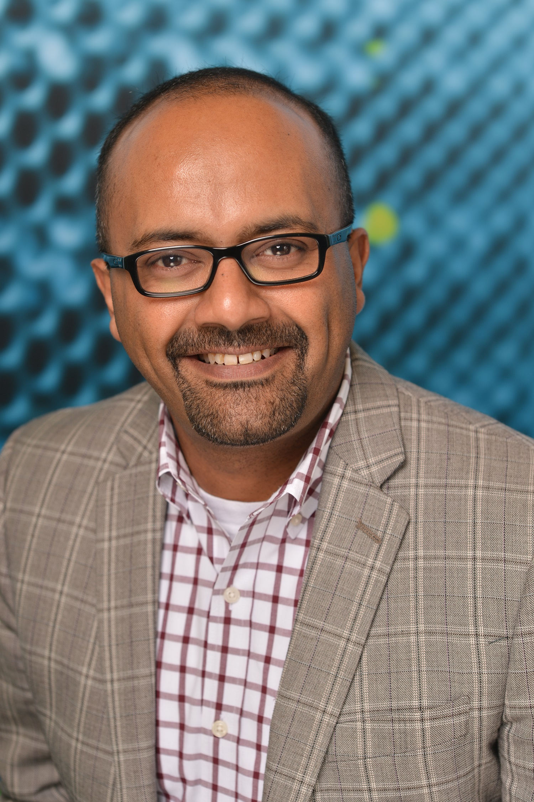
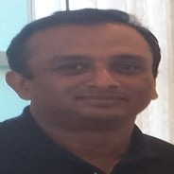

Introductions
Joseph Lambert Rajadurai
Douglas McCuaig
Martin Williams
Venkat Sahay
Global Head of Travel & Hospitality Services
Executive Sponsor
Transformation Leader
Program Director
Deepak Parameswaran
Krishna Indukumar
Venugopal Ramachandran
Technology Services Leader
Digital Engineering
Lead
Quality Assurance
Lead

Slide 3
Agenda
1
Executive Summary
2
Strategic Foresight
3
Solution Deep Dive
4
Experience & Case Studies
5
Appendices

Slide 4
Executive Summary

Slide 5
We understand your objectives….
YOUR BUSINESS STRATEGY
..ENABLED BY
PROGRAM OBJECTIVES
Customer Engagement
Revenue Enhancement & Cost Transformation
Culture Change
International Growth
A Singular Vision
To be a world-class team & trusted technology partner to fuel innovative & digital solutions
Safe, Secure &
Reliable Operations
Transformational Programs
Service Quality and Continuity
Data & Digital
as the new fuel
Engaged Teams
Efficiency and Cost
Run & Maintain / Transformation
Business Enablement
Business Enablement

Slide 6











Key capabilities to deliver desired outcomes…
Safe, Secure &
Reliable Operations
COMPLEX TRANSITION EXPERIENCE
CULTURAL ALIGNMENT & CHANGE MANAGEMENT
FLEXIBILITY & AGILITY
Transformational Programs
Service Quality and Continuity
Data & Digital
as the new fuel
ALWAYS-ON SERVICE DELIVERY
OPERATIONAL EFFICIENCY AT SCALE
CONTINUOUS SERVICE
IMPROVEMENT
Engaged Teams
Efficiency and Cost
Run & Maintain / Transformation
Business Enablement
AIRLINE INDUSTRY EXPERTISE
INNOVATION &
TRANSFORMATION
AUTOMATION, CLOUD, AI & MODERN ENGINEERING
Business Enablement
INTEGRATED RUN - SMARTOPS
BUSINESS ALIGNED SERVICES
PROGRAM & PORTFOLIO MANAGEMENT

Slide 7
















..Leveraging a vast Global Aviation Practice Footprint
Network, Fleet & Commercial Planning
Reservation &
Sales
Flight
Operations
Cargo
Operations
Airline Finance & Accounting
Tech Ops
& MRO
CRM &
Loyalty
Inventory & Pricing
Alliance Partnership
Revenue
Management
Crew
Operations
Airport
Operations
Ground
Operations
Ecommerce and Mobility

Slide 8
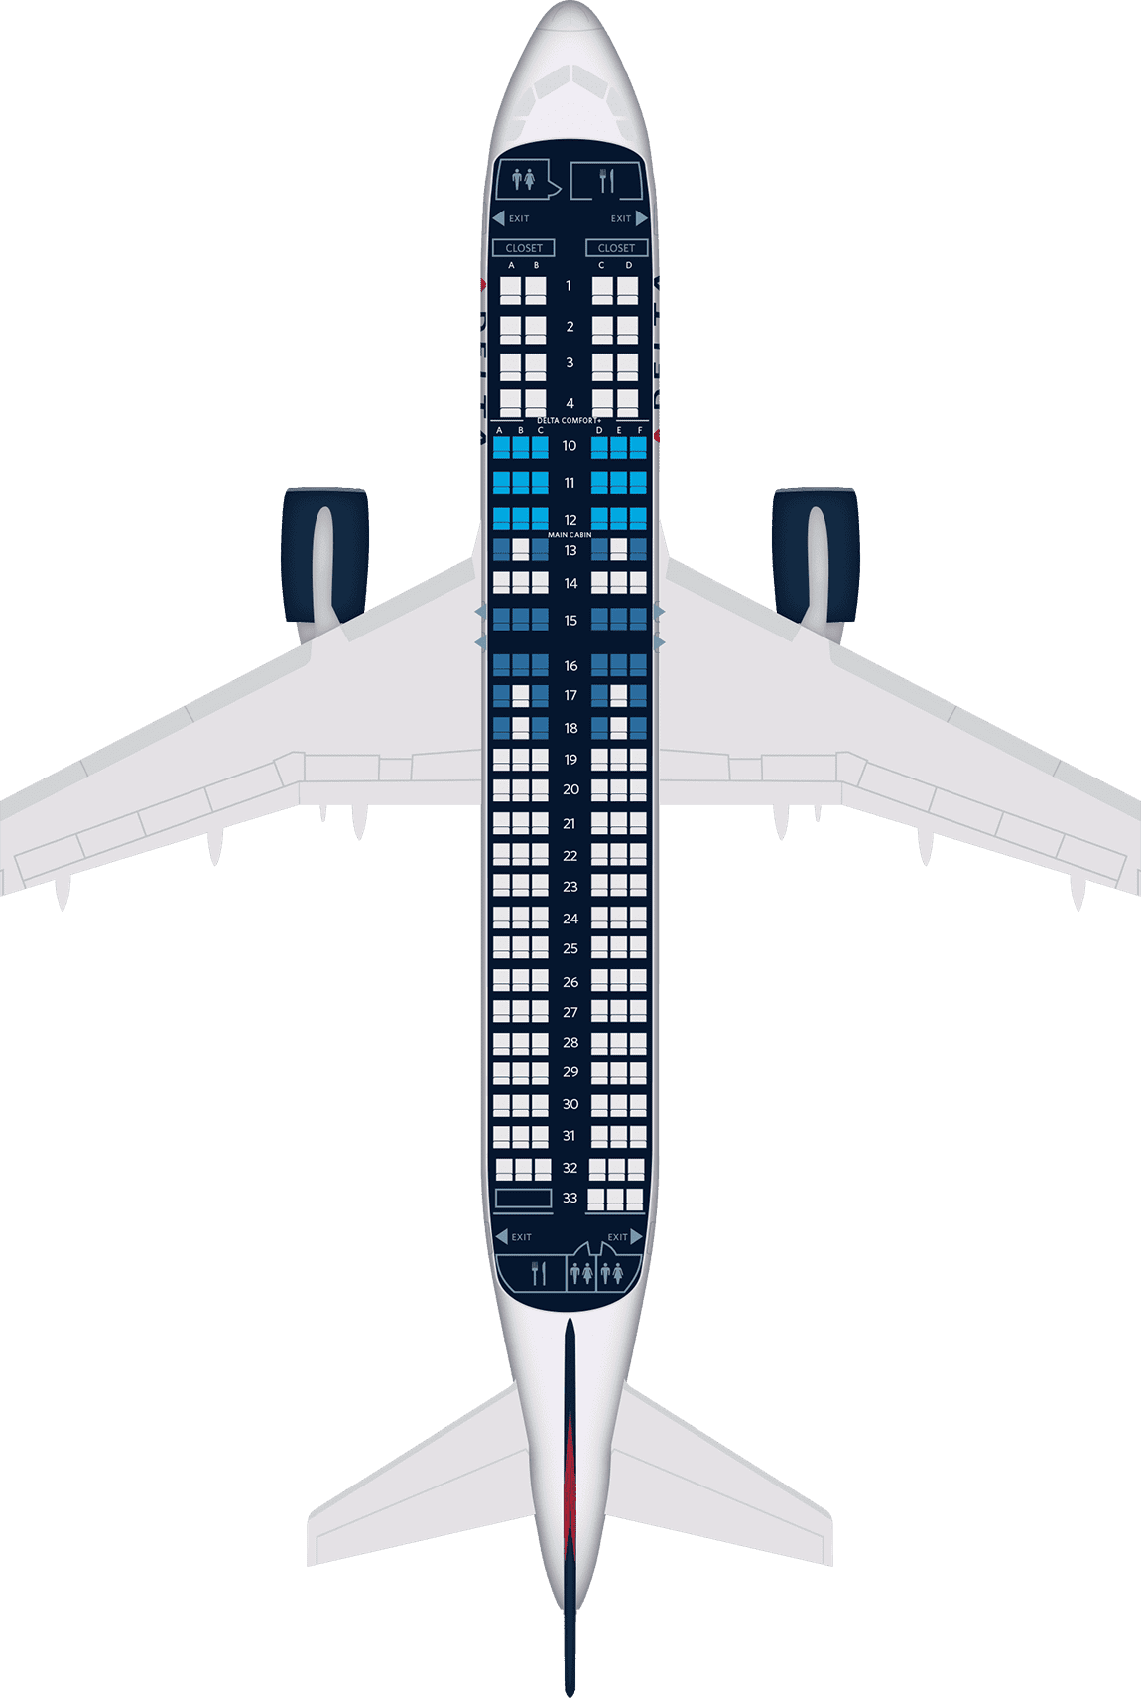
...While incorporating best practices from other industries
Understand Consumer Behavior (Personalization)
Adapt Consumer Experiences through Emerging Technologies
Evolve the Supply Chain
“Glocal” – Global Consumer Needs, Local Execution
Engage Like a Disruptive Retailer, Execute like a Best-in-Class Airline
Apply Design Thinking
Evolve Product Mindset to Include AI, ML, Agile
Deploy NextGen SCM - Blockchain, Robotics, RPA
Augment Global Scale with Regional Delivery Centers

Slide 9
Our solution blue print to deliver these capabilities
Objectives
Our Solution Tenets
Safe, Secure & Reliable Operations
Transition and Stabilize with minimal disruption
LAND SAFE
Risk Mitigated Transition – ADAPTTM Framework
Operating Model Transformation
Organizational Change Management (OCM)
Process and Tools Enablement
Transformational Programs
RUN BETTER
Drive IT Efficiency @ scale
Data & Digital as the new fuel
HiveCenterTM enabled Automation
Debt Elimination – Zero
Maintenance. Framework
Service Introduction
Employee Experience - DigiHub, UXD, Self heal
RUN DIFFERENT
Engaged teams
Deliver predictable business outcomes
Hybrid Agile Model
Release and Build - DevSecOps Platform
Build a Cloud first foundation
Accelerate Standardization & Modernization
Run & Maintain transformation
BE DIFFERENT
Enrich Customer & Employee Experience
Business Enablement
Business Value Management (BVM)
Cloud Migration & Legacy Modernization
Innovation Led Transformation
Enhanced Customer Experience

Slide 10
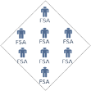
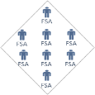
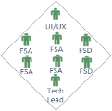
..Enabled by a Transformed Delivery Model
Portfolios
Airline
Customer
Airline
Operations
PSS
Cargo
Enterprise
Technology Software
Integrated Operations
Service Desk | Command Center | Control Tower | Security Operations Center
Platforms
HiveCenter | OneAgility | LEAP | Business Service Catalog | CloudSteps (Saas / PaaS ) | Microservices |
POD & Delivery Teams
Technology Operations
SmartOps - Digital Command Center| Infrastructure | App Management | Hybrid Cloud Ops |
Security Operations Center | Shared Services
Foundational Services
Enterprise Software & Tools | Automation | Cloud | Agile
Governance
Program Management Office | Service Management Office | Business Governance & Reporting | Service Integration & Management | Organization Change Management | Transition Office
Cyber Security
IAM | Infra, App & Data Security | DevSecTestOps | Digital Security | GRC - GDPR | Pipeda | PCI - DSS
Enablers
Enterprise Software & Tools | Frameworks | Delivery Excellence | Partnership & Alliance | Talent Management | Learning & Development | Human Resources
Air Canada Functional Areas
Business Partner | Digital & Technology | Delivery & Operations | Cyber Security | Shared Services | Major Projects

Slide 11


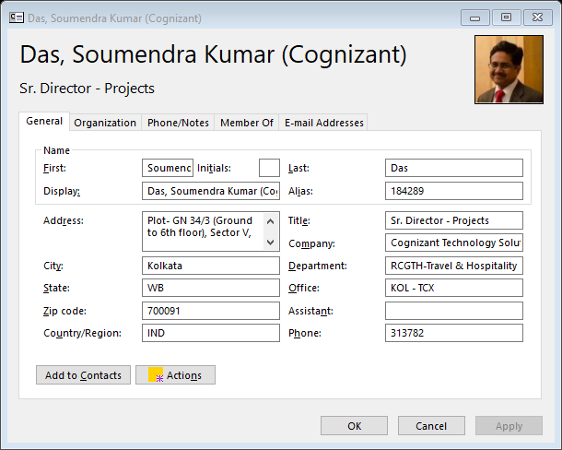

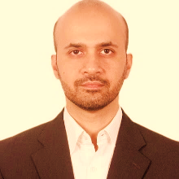
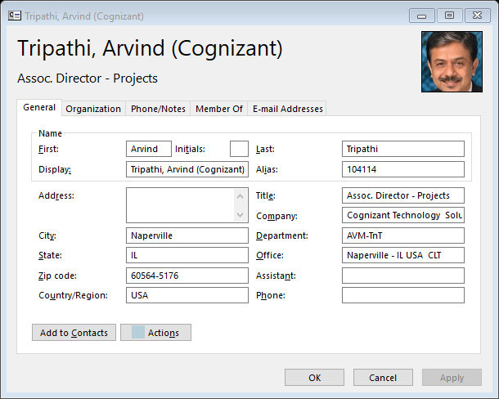
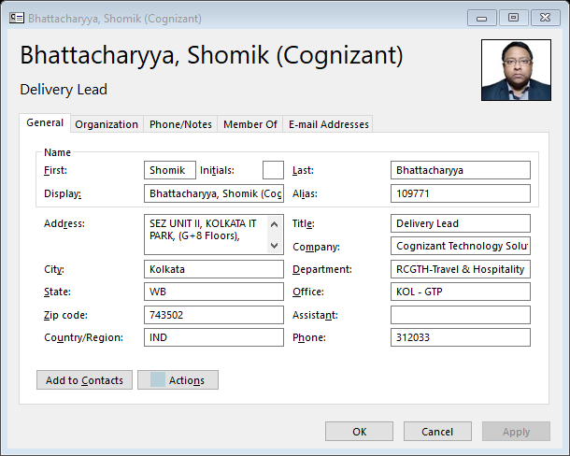
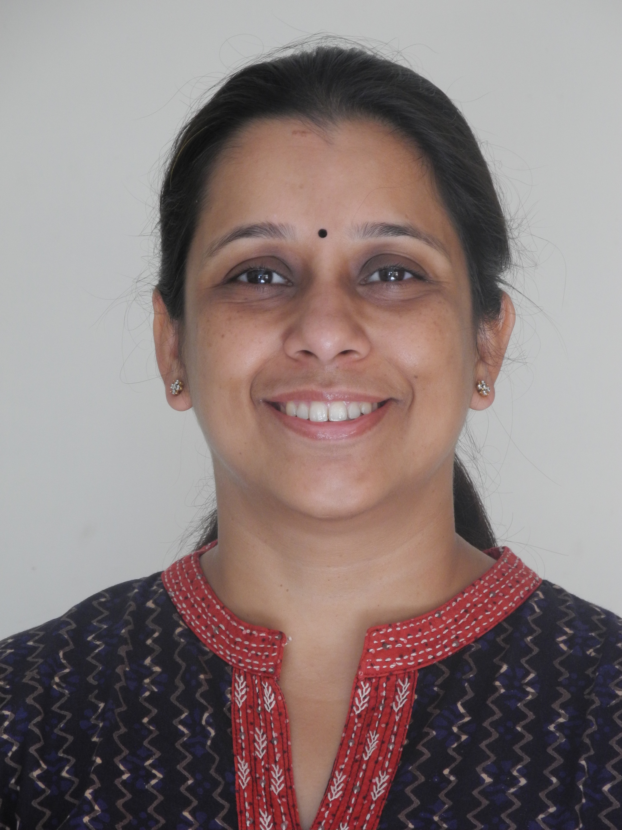
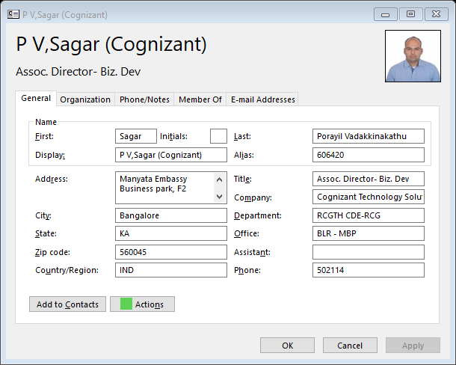


..Managed by an Integrated Governance model
Global Leadership
Account Leadership Dedicated to Air Canada
Update Missing Pic
Steering
Committee
Delivery Leadership Dedicated to Air Canada
Joseph Lambert Rajadurai
Global Head of Travel and Hospitality Services
Douglas McCuaig
Executive Sponsor
AMS CoE
Executive Sponsors
Soumendra Kumar Das
Regional Head Travel & Hospitality
Deepak Parameswaran
Technology Services Leader
Automation CoE
Global IT Lead
Sumit Mehrotra
Client Partner
Service Mgmt. Office
Consulting
Venkateshwar Sahay
Program Director, US
Ankur Banerjee
Program Director, India
Arvind Tripathi
Transition Director
Service Directors / Managers
Technology CoE
Quality
Service Delivery Team
Tools & Enablers
SMEs
Shomik Bhattacharya
Program Manager, India
Debjani Acharya
AVM Service Delivery Director, India
Sagar P V
CDE Service Delivery Lead, India
TBD
Technology Services Delivery Lead, India
Sanjib Kumar Mitra
QA Service Delivery Lead, India
End Users

Slide 12
..That delivers impactful outcomes
Review & Modify
REDUCE THE RUN EFFORT OVER NEXT 5 YEARS
TRANSFORM
Elimination of 5% tickets
Reduction in tickets that are being resolved by Service Desk
Reduction in tickets flowing down to L2/L3 Layers
Integrated App Development & Transformation Approach delivering..
‘Keep the Business Running’
Deliver Projects & enhancements with Cycle Time Reduction enabled by QA Automation Coverage
Enhanced TEAM MEMBER EXPERIENCE
Improved STABILITY and RELIABILITY
Matured & Transformed IT OPERATIONS
Enhanced CYBER SECURITY OPERATIONS
Automation (with Improved Self Service and Self-Heal)
Reduction in MTTR in Infra tickets
‘Agile’ Public Cloud service operations
Key Security Metrics aligned with NIST standards
‘Accelerate Transformation’
Enable seamless Cloud Migration
High CSAT - Customer Delight
Improvement in MTTR in Application tickets
Integrated Process & Rationalized Tools landscape
Improved Vulnerability Remediation effectiveness through prioritization
‘Transformed Operating Model’
Cloud Native dev in PODs with Faster Time-to-Market
Improvement in FCR
Reduction in MTTR through Integrated SOC Operations
Business Aligned Service Delivery - Shift from IT to Business SLAs
Enhanced Cyber Risk Mitigation through proactive operations
‘Transformed Business Model’
Faster MVPs with Joint Innovation Labs & Investments

Slide 13

Enabling Air Canada to Become a Top Global Carrier
Seamless, On-the-Go Rewards Program to Drive customer loyalty
Consistent and Reliable Product Delivery
Employee
Empowerment through Digital Adoption
Human-Centric Customer Engagement
AI and ML Assisted Service Desk Support
Customer
Focus
Operations
Focus
Uniform, Best-in-Class Brand Experiences across Channels and Customer Segments
“Anytime, Anywhere” Availability of Products and Services
Proactive, Data-Driven Product Suggestions

Slide 14
..delivered over next 24 months.
Review & Modify
Proven Transition Framework - ADAPT™
Focus on Organization Change Management
Steady State
Optimized Managed Services
BIC
Managed Services
Land Safe
Business – IT Alignment (LOB Aligned Teams)
Robust Joint Governance (AC, Incumbent, Cognizant)
Industrialized
Operations
Control Tower Implementation
Establish Adaptive Data Foundation
Run Better
Cognitive SmartOps
QA to QE Transformation
Application Landscape Rationalization
Debt Elimination through Zero Maintenance Framework
Run Different
Zero Touch Operations - AI/ML-Based Intelligent Automation
Digital User Engagement
Next Gen’ AI/ML – Shield
Digital Experience Center
Be Different
Scale Agile /DevSecTestOps
Intelligent Enterprise with Human-Centric Design Thinking-Led Insight as-a-Service
3-9 months
9-18 months
18+ months
Key Outcomes
Strategic & Tactical Priorities, Implementation Roadmap
Reliable and Stable Delivery & Operation
Increased Speed to Market
Growth Driven by Digital & Data
Future Proofing

Slide 15


Helping Industry Leaders in their Digital Journeys (1/2)
American agrochemical & agricultural biotechnology corporation
Largest American service provider for top farm equipment manufacturer
Largest Department Store Chain in the US
24X7 Multi geo Managed Services Support & Development
24X7 Multi geo Managed Services Infra and App Support
24X7 Integrated Managed Services Support for Apps and Infra Services
30+ agile pods
84% reduction in MTTR
56% cycle time reduction (apps)
172% increase in seed sales
300+ facilities and plants
$25 M savings on operations
90% total backlog reduction
85% transactional CSAT
1400 stores
$14.5 M savings over 4 years
55% decrease in resolution time
4.4/5 CSAT score

Slide 16




Helping Industry Leaders in their Digital Journeys (2/2)
Revenue Augmentation by Embracing
Digital Channels
Reimagined Digital Guest Experience
Data-Driven
Customer Experience Transformation
35+% increase in cargo revenue from eCommerce portal
10% YoY revenue increase in flight revenue from omnichannel offerings
5% increase in customer base across the globe, annually
75% reduction in time-to-market
Improved QSM score, réputation enhancement
Increase in cross-selling and up-selling of airport products and services online

Slide 17
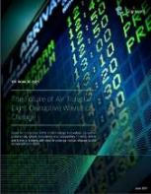
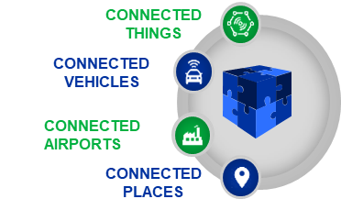
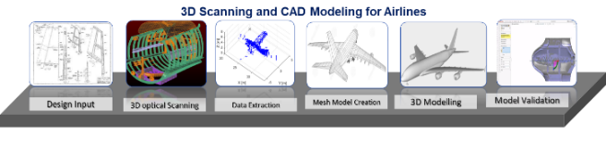
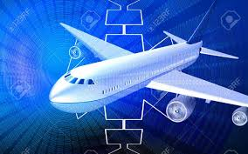
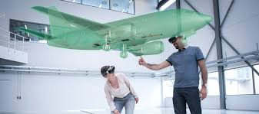
At the Forefront of Thought Leadership & NextGen Technology
Industry-Leading Assets and Thought Leadership
Enabling Clients to “Be different” – Leverage Our Significant Footprint in Next Gen Technology in Aviation Sector
The Future of Air Travel: Eight Disruptive Waves of Change
IPs
TBAAR
Airlines Ecommerce &
Merchandising
Multi-Modal Logistics
Tracking System
Digital Field Transformation for
Large US-Based Airlines
Partnered with client to create digital database of fleet, enabling them to implement wide-array of applications to improve efficiency, safety and productivity
Enabling MRO Technician Training for Middle-East Carrier
Used HoloLens to deliver service training to Field Service Engineers (FSEs) through mobile-based solution and virtual experiences
Airlines BPM
Business Process Models
Notes:
Corporate Systems
Development of a Crew Payroll system for a leading US based carrier
Revamp of e-learning and Training systems of a leading Airline in the US
Specialized ERP (such as SAP - FICO, SAP - HCM) implementation and maintenance
Pricing and Marketing
World’s Largest Loyalty system implementation for a Tier 1 Airline
Migration of legacy loyalty platforms to specialized systems (Siebel, MS CRM, Salesforce)
Big Data Analytics of customer purchase behavior and competitor pricing
Sales and Distribution
PSS system validation for a Leading Mid-East airline
Complete revamp of .com website as for a Major US Airline
Using NDC providing Omni channel travel shopping experience
Ground Operations
Multiple projects executed for Tier 1 Airlines across:
Baggage Handling
Self Service Kiosks
Airport Operations Metrics
Mobile / Tablet Enablement
Flight Operations
Integration of Maintenance and Engineering (M&E) systems of two major US based airlines
Development of a Disruption Management system for a leading UK based airline
Mobile Solution Development for Line Maintenance technician workflow
Mobile Web Solutions for Flight Performance Statistics

Slide 18
Strategic Foresight

Slide 19

Unlike marketing and commercial teams that can respond nimbly to market shifts, IT need to invest significantly ahead of experience expectations – so the business is ready when new experience expectations manifest.
Notes:
To kick things off at the beginning of our session …...X talked through two studies that explored….... The Future of Mobility (Petro-Canada), The Future of Buisness Travel, The Future of Giving, The Future of Wealth, The Future of Personalization, The Future of Science, The Future of
The success of those studies is based on an understanding of a fundamental truth in Food businesses, and most large businesses at large:
Unlike…....
These investments are often large CapEx. Complex, and resource intensive. Perhaps even more so in the airline industry, given how complex the business and technology ecosystems are.
Put another way, these are big bets. Given the magnitude of these investments, how is Air Canada anticipating and preparing for the yet uncertain future?

Slide 20
As you transform the internal IT organization in order to support the Air Canada of the Future, how are you limiting the amount of uncertainty that the future holds?

Slide 21

We use foresight to :
THE FORESIGHT
EFFECT:
How does it impact an organization?
Challenge existing vision, strategy and solutions
Uncover gaps in organizational knowledge and capability
Develop and socializing alternative vision, strategy and solutions
Define planning and solution requirements
Notes:
Strategic Foresight is the capability and methodology that Cognizant uses to help our clients anticipate and prepare for change. It enables us to create and maintain a high fidelity, cogent and functional future forward view…..and turn these insights into value for our clients
Foresight is not a forecasting methodology in which we use past data to project what the future will be like. Rather, foresight helps us imagine and prepare for a range of possible futures in living detail through examining emerging signals of change.
For many companies, foresight is a key activity in limiting the amount of uncertainty they face. Less uncertainty means that they can:
Challenge existing vision, strategy and solutions…....by wind tunneling these against multiple potential scenarios or ‘ future worlds’
Uncover gaps in organizational knowledge and capability ‘ one you know where the market is moving, you can take a critical lense to your capabilities, (people, processes, technology, to highlight gaps and opportunities
Develop and socializing alternative vision, strategy and solutions
Define planning and solution requirements
/ Avoid unwanted surprises
/ Discover new opportunities
/ Address weaknesses early
/ Uncover game changing strategy
/ Collect energy around a vision

Slide 22


How is strategic foresight different than strategic planning?
strategic planning
strategic foresight
reactively gathers trends
narrow in scope, focused on current view
executive exercise
focuses on exploring a single future
prepares us for changes to our operating environment
starts from today, works forward
intentionally cultivates trends
broad in scope, explores society, technology, politics, etc.
org-wide exercise
focuses on exploring multiple futures
prepares us for changes to the world
starts from tomorrow, works backward
Traditional notions of strategic planning use existing data and mental models to craft a strategy that prepares organizations for the present. This means that when the future arrives, these organizations are often stuck in the past, and at a competitive disadvantage.
Notes:
Foresight is not a forecasting methodology in which we use past data to project what the future will be like. Rather, foresight helps us imagine and prepare for a range of possible futures in living detail through examining emerging signals of change.

Slide 23








We’ve done this across Canada, across industries
Notes:
Add 2-3 IT examples
The intersting part of this is the capabilities that our client will invest in to enable this opportunity at scale. They, like you recognize that Food Co’s have been slow to leverage digital techniologies to stay ahead of consumer demand, so are leveraging this strategic capabilities map as their north star to guide their IT & R&D invetsments
Here are three tangible IT examples that are being built out to enable this platform;
/ personalized, functional nutrition is about a 1:1 relationship between brands and people, and the ability of these brands to leverage their consumers’ biomarkers, and genetic data, and translate this into a personalized and customized portfolio of products, and tailored nutrition plan…..
/ this is all about data and being abel to translate this data into
1 is a more dynamic, agile data capability whereby they can leverage disperate data, from CRM, POS, biometric and genetic data and translate these to insights on a 1:1 level that commercial and marketing teams can translate into product innovation
/ since this is about personalized functional nutrition, trust is paramount, as such advanced food safety is necessary, so how do they enable greater speed to market and really become world class within food safety and transparency, through the entire supply chain. Here we’ve framed opportunities to both build and partner with Food Safety food tech companies like FoodLogio, Ripe.I.O, automation, such that product could be develioped faster and safer
/ the second is a D2C platform so that these personalized nutrition products and services can be delivered directly to consumers

Slide 24

Petro Canada
TRANSFORMING THE CUSTOMER & CONSUMER EXPERIENCE
THE BRIEF
In order to proactively create competitive differentiation, build resiliency, and address changing customer expectations relating to the mobility, energy, and technology spaces, Petro-Canada sought to future proof it’s10 year growth strategy through a rigorous strategic foresight and human-centered insights study, for both the retail and wholesale businesses.
THE OUTCOME
Executive alignment and endorsement at both the Petro-Canada and Suncor levels of a 10 year strategic plan, underpinned by a robust roadmap that illustrates the run the business and transform the business initiatives.
The 10 year strategy was further translated into discreet projects designed to transform the engagement model, business model, and operating model in order to be ready for a more diverse mobility future.
Foundational Insights
15
10 Year Strategy
1
New GX Blueprint
2
New CX Vision
2
New Service Concepts
1
New CX Portfolio
12
Notes:
Add 2-3 IT examples
The intersting part of this is the capabilities that our client will invest in to enable this opportunity at scale. They, like you recognize that Food Co’s have been slow to leverage digital techniologies to stay ahead of consumer demand, so are leveraging this strategic capabilities map as their north star to guide their IT & R&D invetsments
Here are three tangible IT examples that are being built out to enable this platform;
/ personalized, functional nutrition is about a 1:1 relationship between brands and people, and the ability of these brands to leverage their consumers’ biomarkers, and genetic data, and translate this into a personalized and customized portfolio of products, and tailored nutrition plan…..
/ this is all about data and being abel to translate this data into
1 is a more dynamic, agile data capability whereby they can leverage disperate data, from CRM, POS, biometric and genetic data and translate these to insights on a 1:1 level that commercial and marketing teams can translate into product innovation
/ since this is about personalized functional nutrition, trust is paramount, as such advanced food safety is necessary, so how do they enable greater speed to market and really become world class within food safety and transparency, through the entire supply chain. Here we’ve framed opportunities to both build and partner with Food Safety food tech companies like FoodLogio, Ripe.I.O, automation, such that product could be develioped faster and safer
/ the second is a D2C platform so that these personalized nutrition products and services can be delivered directly to consumers

Slide 25
Solution Deep Dive

Slide 26
Solution Deep Dive
Please modify if we don’t have a Technology Services Deep dive solution section
1
Modernize and Transform
2
Technology Services Solution
3
Land Safe – Transition and OCM
4
Innovation & Advisory
5
Governance

Slide 27
Modernize and Transform

Slide 28
Key Priorities and Drivers for IT 2020 Transformation
Transform to Dynamic Operating Model
Build a Cloud Native/Agile Culture which can deliver business demands with speed and quality
01
Accelarate IT Landscape transformation
02
Embark on migration to a cloud first approach driven around automation
Factors influencing Application Development and Transformation Approach
03
Prioritization of business impacting projects to ‘Keep the business running’
Drive projects and programs with minimal impact to ongoing business
04
Transform the Business Model to anticipate and prepare for change
Enable business to nimbly respond to market shifts and help achieve their business strategy

Slide 29
Approach to IT 2020 Transformation – Accelerate with Purpose
Our Approach
Outcomes
Drivers
Powering up IT with Strategic Foresight
Foresights to Insights Model
Identify and Deliver IT capabilities for Insights
Faster MVPs with Joint Innovation Labs & Investments
‘Transform Business Model’
Focused on Cloud Migration, Legacy Modernization, Data & Platform Modernization, DevSecOps
Modernize IT Platform
~80% Cloud Native Migration before 2020
Increased Savings (TCO & Opex Reduction)
Stable & Scalable IT Platform
‘Transform to Dynamic Operating Model’
Integrated QE & Rapid Response Team
‘Accelerate Transformation’
Capacity based teams to drive Small Projects, Major Enhancements and Automation
~20% Cycle Time Reduction
~80% QA Automation Coverage
Zero Critical Defects in Production
‘Keep the Business Running’
POD based operating model to fully leverage Cloud Native ecosystem
Enable Product Based Organization
~60-70% Cloud Native dev in PODs
~25-30% Faster Time-to-Market
~50% Reduction in Post Production Fallouts

Slide 30
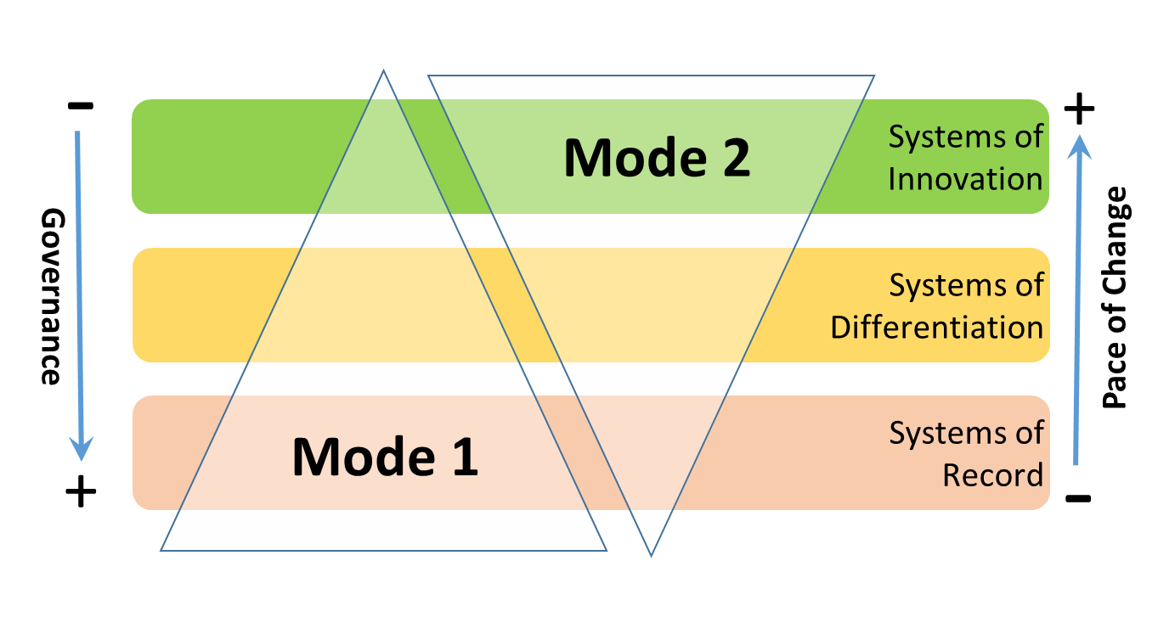

Approach to Digital Transformation – Drive Operational Efficiency @ Scale
Cognizant recommends Air Canada adopt a Bi-Modal IT Strategy focusing on Two- Speed & Pace-layered approach is key to accomplishing the dual mandate of Driving deep Customer experience and Operational excellence
Mode 1 Operational excellence
Mode 2 Business Agility
Transactional Processing & Operations
Impacts Customer Experience
Established, Stable, Industry standard
Creative, Exploratory, Differentiated
Long term planning horizon
more capex moving to Opex
Short term planning, predominantly Opex
KEY TRAITS | SYSTEMS OF INNOVATION | SYSTEMS OF DIFFERENTIATION | SYSTEMS OF RECORD
Strategic Focus | Engage like disruptive retailer | Increase passenger traffic | On time performance and consistent operations
Pace of change | Rapid, Frequent, Adhoc | Moderate, More Frequent, Configurability | Slow, Infrequent, Incremental
Planning horizon | LOW | MEDIUM | HIGH
Agile Maturity Need | High | Moderate | Moderate
DevOps | High | Moderate | RPA
Cloud | End User Experience/ Scalability | Differentiation/Time to market | Operational Excellence
Example Applications | Aircanada.com, Mobile apps, Reservations, Loyalty | Altitude, Cargo (B2B) , Crew Management , Network Schedules | Airport Operations, Aircraft Maintenance and engineering
…This approach allows Air Canada to build a prioritization catalog focusing around key business products while driving ROI on transformation…

Slide 31


Being Digital – Key Attributes
Laying the Foundation
Modernize IT platform
Drive IT Efficiency at Scale
Enable Faster Transformation
Proven Transition Framework
Product & Platforms based approach
Agile & DevSecOps driven Delivery, Increased level of Collaboration
Assessments / Baseline current maturity and identify KPIs to measure
Core modernization driven by ROIs & Business value
Mobile First Responsive design approach
Setup Foundation –
Agile & DevSecOps CoE, Cloud CoE
Multi Speed IT & transition to Pod based delivery model
Business Transformation
Build roadmap for transition to Product based organization and POD based delivery
App led IT Rationalization –Future proofing
Workforce & Organization Transformation – Organization Change Management
Cognizant Enablers
Transformation Office | Talent Management | Academy | Accelerators | Digital | Partnership & Alliance | Delivery Excellence

Slide 32



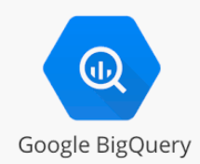








Being Digital – Product and Platforms
Business Capabilities Domain
Omni Channel Customer Engagement
Sales, Service, Mktg.,
Trade, Orders
Product Design, Manufacturing & SC
Corporate functions
Social
Mobile Apps
Web
Sales
Service
Marketing
Product Directory / PIM
Supply chain planning
Transportation Mgmt.
General Accounting
Procure materials & services
Sustainability
Portals
Call Center
SMS / Email / Chat
Trade
Order Mgmt.
Manufacturing
Supply chain Execution
Tax & Treasury
Human capital management
Engineering & Technology Domain
Application Platforms
Technology Platforms
Analytics/Reporting Platform
SaaS
ERP
SCM
MDM
PaaS
UX
API
Security
Cloud
PaaS
Reporting & Dashboards
HCM
CRM
PLM
Logging
Error handling
DevSecOps
Data Lake, ML, AI
PaaS
Custom Applications / Micro Services
Support platforms
Financial
PLM
Retail
Service Management
DevOps
Database
Languages &
Frameworks
Hosting Platform
Reference
Technologies

Slide 33
Being Digital – Re-Cap-Integrated Plan ,Build and Run – Future State
Portfolios
Airline
Customer
Airline
Operations
PSS
Cargo
Enterprise
Technology Software
Integrated Operations
Service Desk | Command Center | Control Tower | Security Operations Center
Platforms
HiveCenter | OneAgility | LEAP | Business Service Catalog | CloudSteps (Saas / PaaS ) | Microservices |
POD & Delivery Teams
Build
Technology Operations
SmartOps - Digital Command Center| Infrastructure | App Management | Hybrid Cloud Ops |
Security Operations Center | Shared Services
Run
Foundational Services
Enterprise Software & Tools | Automation | Cloud | Agile
Program Management Office | Service Management Office | Business Governance & Reporting | Service Integration & Management | Organization Change Management | Transition Office
Cyber Security
IAM | Infra, App & Data Security | DevSecTestOps | Digital Security | GRC - GDPR | Pipeda | PCI - DSS
Enablers
Enterprise Software & Tools | Frameworks | Delivery Excellence | Partnership & Alliance | Talent Management | Learning & Development | Human Resources
Plan
Air Canada Functional Areas
Business Partner | Digital & Technology | Delivery & Operations | Cyber Security | Shared Services | Major Projects

Slide 34
Being Digital – Operational Maturity Journey
Engineering Ops
DevOps
ZeroOps
Zero downtime
Deployments
App Path
Ops-less CI/CD
Use IaC blue prints for self-service
Optimize the code for DevOps
Cloud Path
Immutable
Self-healing environments
Blue-Green
Environments
IEaaS
Operations Maturity
APM
Application Modernization
Self-healing
Cloud Resource Democratization
Adopt Containerisation, Server-less
IaC Pipelines
Adopt Core Cloud Native Services
Self-Service through code
Modernize Legacy in Cloud
AI/ML Infusion
App Assessment
Catalogue & Self-Service
RPA /
Change Automation
Standardisation
& Governance
Bi-Modal
Integration
Event correlation
and reduction
Time

Slide 35


Our Vision is aligned to your goals of transforming ADM services to a modern ‘Digital Engineering Practice’
Future State – NextGen Digital Engineering
Airline Customer
Airline Ops
Enterprise
PSS
Cargo
Tech
Governance
Program Sponsorship & Budgeting | Integrated ADM Business Review
Quality Advisory Board | Transformation Governance
Current State ADM
Engagement
Modern Engineering
Modern Teams
Modern Process
Modern Platforms
Customer
Enterprise
Ops
PSS
Cargo
Application Development Services
Intelligence
Digital Enablement
Cloud Native & Microservices based
Debt Elimination
Collaborative AD/AMS/QE Model
QA to QE Transformation
POD based delivery
Delivery Processes & Methodologies for Waterfall/ Agile & DevSecTestOps
SmartOps Delivery
Self Healing/ Self Service
Lifecycle Automation – Zero Touch QA
Zero Touch Ops
HiveCenter
Digital On Ramp
AI driven data platform
Application Maintenance Services
Application System Quality Assurance & Testing Services
Scale
Shared Services
Automation Factory | Regression Factory | Tools Support | Device Farms

Slide 36


Transforming QA to ‘Next Gen Quality Engineering’ function enabling Quality @ Speed and assuring Customer Trust
Process
QEA Differentiators
Shift-left
Shift-Right
LEAP
Quality orchestration platform for continuous testing across the SDLC
Run Better –
Building on the QA foundation to drive efficiencies
Static Testing, URS/FS Review
Model Based Test Automation
Business Process Assurance
Integrated Quality Engineering aligned to SDLC
In sprint Functional & Automation Testing, Regression Automation,
Performance, Resiliency, Accessibility & Security Testing
Airlines in a Box
Reusable test assets for Business Process Assurance
People
Technology
Platforms
Quality Insights Platform
AI based insights driven QE BOTs across SDLC
Run Different –
Delivering predictable business outcomes and assuring Customer Trust
QA to QE Transformation
Enable Continuous Testing with CI/CD Integration
Enable Continuous Delivery with AI driven QE BOTs
CX Assurance Framework
Sentiment Analysis &NPS measurement

Slide 37

Leveraging an approach towards Integrated ( Shift Left) QE
IP ITERATION
PI PLANNING
SPRINT ‘1’
SPRINT ‘2’
SPRINT ‘N’
FULL SOLUTION INTEGRATION
Requirements Gathering & Design Approvals
3. Test Data Automation
E2E Integration Testing
4. In Sprint Functional Automation
Automation Feasibility Study
SPRINT LEVEL ACTIVITIES
Sprint Planning
Daily Stand-Up Meetings
Sprint Review/ Demo
Sprint Retrospective
Quality Engineering aligned to CI/CD (DevOps)
Release Regression Automation
5. Early Performance Automation
Non-functional Testing
(Performance/ Security/ Accessibility)
Test Strategy Creation
2. Build Validation & Smoke Automation
Tool Setup –Automation & Continuous Integration
User Acceptance Testing
6. Code Quality Review and Approvals
Customer Experience Testing
1. Code Build, Unit Tests and Continuous Integration
Environment Readiness Checks
7. Sprint Level Regression Automation
Test Closure & Sign-off
IP Iteration
Code Launch
Key Deliverables: Test Strategy, Definition of Done
Key Deliverables: Test Cases/ Scripts, Test Execution Logs, Defect Logs, Metrics & Reports
LAUNCH
Quality Gates aligned with Acceptance Criteria
Leverage “Airlines-in-a-box” a repository of various artefacts/tools & frameworks /documents/best practices/processes (technical, functional, business, etc.) & Experience insights from our past and ongoing Airlines engagements

Slide 38


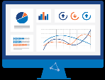

Deploying Lifecycle Automation solutions to make QE invisible in integrated framework
Continuous Improvement
REQUIREMENTS
DEVELOPMENT
SMART ENVIRONMENTS
RELEASE
REQUIREMENT
CODING
BUILD
RELEASE
DEFINITION
DEV
ENVIRONMENT
QA
ENVIRONMENT
STAGE
ENVIRONMENT
PROD
ENVIRONMENT
CHANGE IMPACT ANALYZER
Virtualized Service Synthetic Data
SMART APM
DEFECT PREDICTOR
SAST
OPERATE
TESTING
AUTO TRIGGER FOR TEST
CONTAINERS
TESTING GAP ANALYZER, TRIAGE BOT
CONTINUOUS INTEGRATION
DAST
BUILD SUCCESS VALIDATION
DevSecOPS
SECURITY
NOTIFICATIONS TO STAKEHOLDERS
IMPACT ANALYSIS & DECISION ENGINE
SPECS GEN
BDD CODE GEN
BVT
SMOKE
INSPRINT
DevSPACE
FUNCTIONAL
REGRESSION
PPV
CENTRALIZED
REPORTING
INSIGHTS (Dashboard)
TEST REPO
CXOPTIMISE
PERFORMANCE
RESILIENCY
RESULT ANALYTICS & FAILURE ANALYSIS
TEST GEN
TEST SCRIPTS
PERFORMANCE
DUPLICATE DEFECT IDENTIFIER; REGRESSION TEST OPTIMIZER; SCHEDULE VARIANCE PREDICTOR
LOADRUNNER
LEAP
Continuous Integration
Continuous Testing
Continuous Delivery
Agile/Devops
Process enablement
In sprint
Automation for Early testing
BDD
Collaboration with Business
LEAP
With UFT for Mainframe / Legacy Automation
CRAFT
With UFT for Mainframe / Legacy Automation
DevSpace
DevOps for Security, Perf & Accessibility
AI Assurance
Machine Learning
Based Assurance
BOTS / CHAT OPS
Intelligent DevOps
Self Healing
environments with continuous monitoring
Full stack Quality engineers into scrum teams
Eliminate Waste and setup High Standard process
Early Automation parallel to application development
Containerized scalable On-Demand Test Environments
Extended data Refresh & Synthetic Data Generation
Automated Production Health check
AI based continuous monitoring and continuous feedback
Cognizant Accelerator
Cognizant Quality Insight BOTS

Slide 39




By gradually transforming into an integrated QE Operating Model with ADM for end to end assurance & certification
Shared Service - QE
PODs ACROSS AIR CANADA APP PORTFOLIO
QE DIRECTOR
TOWER QE LEAD
PRODUCT OWNER
DELIVERY OWNER
ARCHITECT
OTHERS
(DEVOPS, SUPPORT)
ACROSS PODs
AUTOMATION ARCHITECT
POD 1
POD 2 ...
PERFORMANCE ARCHITECT
PROCESS CONSULTANT
QUALITY ENGINEER
DEVELOPER
SCRUM MASTER
UI/UX ENGINEER
QUALITY ENGINEER
DEVELOPER
SCRUM MASTER
UI/UX ENGINEER
TEST DATA ARCHITECT
PERFORMANCE ENGINEER
Service Virtualization ENGINEER
SECURITY TESTER
ENVIRONMENT TEAM
TEST ENV/VIRTUALIZATION
ARCHITECT
END to END Certification Team
FUNCTIONAL TEST
ARCHITECT
FLEX QA POOL
TECHNICAL/FUNCTIONAL
SMES
FOUNDRY
Technology Transformation – Zero Touch QE & Digital
Process Transformation –
“Shift Left” QE
Workforce Enablement –
“QA to QE”

Slide 40

Using the latest platforms, tools and accelerators for Quality at Speed
LEAP as an orchestration platform to bring in continuous testing across the SDLC
Quality Insights Platform to enable artificial intelligence across SDLC (Defect Prediction Bot based on code changes impact, Triage Bot etc)
LEAP
Lifecycle Engineering Automation Platform
Airlines in a Box
Reusable test assets for Business Process Assurance
CX Assurance Framework
Sentiment Analysis &NPS measurement

Slide 41
And elevating QE to assure business outcome – guardian of quality and customer trust
Update Business Metrics
DELIVERY METRICS
%
BUSINESS METRICS
Sprint Velocity
Cycle Time
Test Automation Leverage
Backlog Management
Application Uptime
Defect Escape Rate
%
Opex to Capex
Earned Business Value
TCO Reduction
NPS/Customer Satisfaction Score
Lead Time (Define to Deploy)
ENGINEERING METRICS
AGILE
/ POD Assurance Success Criteria
Code Quality
Technical debt
Lifecycle Automation Leverage
Code Reusability Index
Resiliency, Scalability, Granularity
%

Slide 42
Technology Services Solution

Slide 43
Technology Services Deep Dive ???
Update If any else remove ?

Slide 44
Land Safe – Transition and OCM

Slide 45
Transition Approach
Transition—Critical Success Factors
Transition—Solution Tenets and Enablers
Key Outcomes
1
Adaptive, Modular, Risk Mitigated Transition
Proven transition methodology and minimal disruption to business
Seamless transition of in-scope services to the managed services model
Modular Transition organized by tower and complexity analysis
Personnel enablement & day-1 core team for KT
Communication and change management
Priority transition for “flight risk” / “At-risk” key SME’s
Innovative fit-for-purpose KT methodologies (person-person, agile)
Day-1 transition governance team for KT execution
Judicious use of Air Canada/incumbent SME time
2
Robust Transition Methodology, Process, Tools and Accelerators
Detailed pre-transition plan & preparation
ADAPT—Cognizant’s proven transition framework
Holistic solution for Air Canada applications/infrastructure—right shoring
Optimum wave planning, prioritization and sequencing
Process convergence & enablement
Mix of in-person & remote KT
3
Targeted deliverables
supplementing Air Canada documentation
Alignment with Air Canada’s IT Organization
Target operating model setup
Transition framework customized to Air Canada’s needs
Onsite—offshore model for effective 24x7 Support
Air Canada culture and best Practices adoption
Joint transition governance aligned to Air Canada IT Services
Quality gates customized to each service line
Joint planning on services and business nuances
Optimize the transition resource plan
Service enhancement through automation and self-help
4
Target Operating Model Setup
Early value realization
Organizational change management
Leverage Air Canada’s tools & process
Foundation for intelligent automation
SMO and governance setup
Productivity tools & dashboards

Slide 46
Transition Framework: ADAPT™
Scientific Model for Application Analysis
First-Hand Information Gathering
Finalize Solution
Comprehensive Onboarding Package
People Alignment
Process Convergence
Infrastructure Set Up
Risk Mitigated Transition
Effectiveness Measurement
A
D
A
P
T
Analysis
Due Diligence
Acclimatization
Process & Infrastructure
Transition
ATI-BRI (Application Transition Index and Business Risk Index) analysis of the in-scope applications
Tool assisted data collection and collaboration
Validate and finalize the Air Canada transition strategy and staffing plan
Asynchronous KT boot camps covering domain, process, technology and environment will be organized to acclimatize the team
Understand Air Canada’s current processes
Socialize common process standards
Support change management
Detailed planning, KA, shadow support, reverse shadow and steady state
Establish governance model and communication plan
Process
Application grouping
Sequencing
Indicative Transition effort and timelines
KT plan and risk management plan
Detailed due diligence Report
Revised transition solution
Asynchronous KT and boot camp training plan
Boot camp scorecard
Identification of change agents
Infrastructure and access provisioning plan
Operational process document
Transition plan, application handbook, status report, metrics
Outcome
Cognizant’s solution conceptualization begins with a detailed analysis of the application and infrastructure data provided by Air Canada.

Slide 47
Transition Governance
Bi-Weekly
Air Canada Sponsor , IT Executives & Transition Manager
Cognizant Transition Manager, Client Partner/ Delivery Partner
­­­­­­­­
­­­­­­­­
­­­­­­­­
­­­­­­­­
Steering Committee
Air Canada Portfolio Managers
Program, Manager
­­­­­­­­
­­­­­­­­
Air Canada Transition Manager
Incumbent Manager
Issue
Cognizant Transition Managers
­­­­­­­­
Escalate
­­­­­­­­
­­­­­­­­
Weekly
­­­­­­­­
Cognizant Applications Manager /Leads
Air Canada SMEs
Incumbent SMEs
Resolve
­­­­­­­­
­­­­­­­­
­­­­­­­­
­­­­­­­­
­­­­­­­­
­­­­­­­­
­­­­­­­­
Transition Management Office (TMO)
Air Canada / Incumbent SMEs &
Team Lead(s)
Issue
Escalate
Project Manager , SMEs &
Team Lead(s)
­­­­­­­­
­­­­­­­­
­­­­­­­­
­­­­­­­­
­­­­­­­­
­­­­­­­­
Leads/SMEs
Cognizant Leads/SMEs
Daily
Resolve
­­­­­­­­
­­­­­­­­
­­­­­­­­
Incumbent Leads/SMEs
Transition Operations Team
Steering Committee
Transition Management Office
Transition Operations Team
Air Canada
Alignment to engagement objectives & outcomes
Manage Air Canada Key Stakeholder Satisfaction
Change Control Approval authority
Prevent critical business disruption
Ensure achievement of goals relating to Schedule, Quality of Transition & Service Delivery and overall transition cost
Enforce Transition rigor and go-live readiness
Ensure no-surprises Transition
Ensure schedule adherence, quality checks
Plan and Implement Service delivery readiness
Detect, analyze and escalate Risks, Actions, Issues, Dependencies
Cognizant
Incumbent
Notes:
Done

Slide 48





Key Risks & Mitigations
Key Risks
Mitigation
Stability of Portfolio-Implementation /Modernization projects during KT
List environment and inflight projects, adjust and agree on timeline during DD, identify core area and work during shadow
Multi Vendors- Lack of collaboration and support
Joint Governance & KT Workflow designed to avoid conflicts Cognizant vendor to vendor and hostile transition approach
Delay in Onboarding & access during asynchronous and synchronous KT
Identify dedicated POC for access provisioning
Resource readiness heat map, Collect Access requirements
Delay in ramp-up owing to talent availability
Access to local talent pool and streamlined on-boarding process to fasten onboarding
SME Attrition, Premature Release of Partner Resources
Knowledge Mining, Self Learning, Exec. Commitment, Joint Governance & Planning
Surge of support incidents impacting knowledge transfer
Prioritize and align KT timeline to absorb business/IT events and SME availability, Incident analysis
Notes:
Done

Slide 49








Proven Change Adoption Framework
Why do we need OCM for Air Canada ?
Infrastructure transformation needs well defined metrics and KPIs to measure success factors
Multiple stakeholder engagement with need for efficient stakeholder management
Culture change at the heart of strategic improvements
Need to identify the change impact on users and make them ready for the change
Change Strategy
Stakeholder Management
Organization Design
Learning & Development
Set overarching strategy for managing change
Establish case for change and project governance structure
Identify the impacted stakeholder groups
Develop working plan to align & engage with leadership
Analyze organization’s design department structure, reporting hierarchy, job definition for transition needs
Prepare end users to successfully perform their role using new systems, processes, tools and operating models
Culture
Value Acceleration Management
Impact Identification & Readiness
Communications
Assess elements that drive an organization’s culture
Determine way to use elements to drive strategic improvements
Define project success measures
Track Key Performance Indicators
Identify audience impact
Tracks audience progression towards readiness
Engage with impacted stakeholder groups to prepare them
Planning, development, and delivery of messages

Slide 50



Using OCM Enablers to Mitigate Possible OCM Challenges
Challenges
OCM Enablers
OCM Mitigations
Communicate expectations for management, sales organization and distributors
Employ a Change Agent Network to include local champions from sales organization as an early adopter group to build confidence with distributor network
Engage leadership to support the change to model desired behavior and influence sales organization
Build a plan and checkpoints to gauge organizational readiness across people, process, and technology
Communications
Change Agent Network
Stakeholder Engagement
Impact and Readiness
Learning and Development
Benefits are not realized or don’t last
End user resistance to adopting new ways of working
Lack of motivation for learning new skills
Behavioral aspect of technological change

Slide 51



Deep Experience Managing Complex Transitions
Engagement
Integrated SD, Apps and Infra services
E2E Infrastructure Support & Testing Services
Multi-tower, cross-technology, dedicated maintenance & support team
E2E Integrated Infrastructure & Application Support
Apps
350+
600+
150+
250+
Geographies
US
Canada
UK
USA, Canada, UK
FTEs
470+
700+
~400
~650
Transitioned
from
Wipro, Accenture, IBM, GeoSpan, Internal
Accenture, TCS, NTT
NIIT
Fujitsu & In House
Business
Benefits
$14.5Mn savings In 4 Years
60% Incident Automation
55% ↓In resolution time
Zero outage during peak support
4.44/5 CSAT Score
$15MN+ savings thru DC consolidation, license rationalization and app transformation
40% Infra Automation
CSAT Score 4.7/5
30% reduction of ticket count in 1 year of steady state
More than $1 MN of service optimization and innovation delivered in a year
Accelerated transition and went live ahead of planned schedule
Successfully supported 2018 peak support immediately after transition
Unit price pricing model
We will leverage our experience managing 200+ transitions over the last 3 years, ranging from 50 to 3,000 FTEs.

Slide 52
Innovation & Advisory

Slide 53






Managed Innovation and Breakthrough Innovation
Airline
Industry
IT Industry
Market Trends
Industry Best Practices
Innovation CoE
Innovation Proposals
Service Analytics Data
Service
Management
Office
Air Canada
IT & Business
Continuous Improvement Ideas
Managed Innovation
Approved
Projects
Transformational
Value
Filtered
Ideas
Air Canada
Innovation Champion
Cognizant
Innovation Champion
Transformational / Continuous Improvement Ideas
PMO
Air Canada’s
Teams
Service
Delivery Teams

Slide 54





Advisory Services to Meet Changing Business Needs
Analytics Consulting
ASK
“Leverage data and analytics for actionable consumer insight”
ASK
CIO Advisory
“International growth led by engaged teams”
Application Modernization
ASK
Advisory
Services
“Modern teams with faster time to market”
Landscape Modernization
ASK
“Simplify IT landscape to reduce Total Cost Of Ownership (TCO)”
Application Portfolio Rationalization
ASK
“Reliable and scalable delivery of applications”

Slide 55
Governance

Slide 56






Transparent and Robust Governance
1 STRUCTURE
2 COMMUNICATION
3 PROCESSES
4 MEASUREMENT
5 TOOLS
Committee Structures and Charts
Communication & Escalation Management
Processes, Policies & Procedures
Business Outcomes,
SLA’s, KPI’s
Reporting and Dashboard Tools and Technology
Identify team members and agree on structure
Single hand to shake
Individual partners
Executive sponsorship
Service management organization and
digital delivery hub
Business aligned SLA
Data-driven governance
CxO dashboard powered by analytics platform with further drill-down capability
Enablers
Agility
Transparency
Collaboration
Stakeholder Satisfaction
Feedback Amplification

Slide 57



Governance Reporting Dashboard
Cognizant’s Executive Dashboard solution generates complex data visualizations to unravel hidden insights and simplifies information consumption across the enterprise
Executive Scorecard (Representative View)
(Provides bird’s eye view of health and trends for IT’s key objectives)
Engagement Scorecard
Score
Trend
Pre-Built KPI Repository
across Air Canada key priorities
Aggregated and
Scalable model
to meet future needs of all business units
Month
 | Demand Management Efficiency
 | Change Management Efficiency
 | Transformation
FY2018-P07
FY2018-P08
Align to IT Strategy
FY2018-P09
FY2018-P10
FY2018-P11
 | Consistent and Aligned Service Levels
 | Critical Applications Health
 | Increase Customer Satisfaction
FY2018-P12
Business Units
Quality of Service
Intuitive Visualization
Covering people metrics, delivery excellence, customer delight, innovation & quality
Multiple Channels of Information Delivery
including web and mobile platforms
Infrastructure
Store Systems
Corporate Systems
Enterprise Systems
…..
………..
Business unit 3
 | Drive Agile Adoption
 | Deliver Flexibility & Scalability
 | Standardize Contracts
Increase Agility
 | Decrease Total Cost of Ownerships
 | Drive Application Rationalization
 | Improve Productivity
Dashboard providing ADS metrics data to all key stakeholders at a leading direct TV marketing company
Mobile BI executive dashboard for a leading financial services firm, resulting in 40% increase in adoption of dashboards across LoBs
Optimize Costs
Time-based snapshot view of each BU across the various parameters
Deep-dive analysis by slicing and dicing details of the dashboard

Slide 58
Cognizant Overview

Slide 59


Company Snapshot
OUR VITALS
Founded
1994
(Nasdaq: CTSH)
Global
Headquarters
Teaneck, New Jersey
270+
Global Offices
~281,600
Employees
December 31, 2018
Revenue
$4.13B in Q4 2018 $16.13B in 2018 (up ~8.9% YoY)
Revenue mix
NA: 76.2%
Europe: 17.9%
RoW: 5.9%
ACCOLADES
COGNIZANT CANADA
11
Fortune
Most Admired Companies 2019
Eleven years in a row
74
Forbes
Best Employers for Women 2018
2,500+
Associates in Canada
40+
Strategic
Clients
16
Barron’s
Most Sustainable Companies 2018
87
Forbes
Top 100 Digital Companies 2018
5,000+
500+
Associates at Regional Development Centers (RDC)
Offshore Resources
195
573
Forbes
Global 2000 2018
Fortune 500 2018

Slide 60










Our DNA : Continuous Digital and People Investments
Social Responsibility
We are committed to giving back to society and encourage a rich work culture based on equality and diversity
Accelerators
Our tools and accelerators leverage AI and data while promoting a platform approach for delivery
Smart Acquisitions
Our acquisitions focus on improving customer engagement and leverage local Canada talent
Investing in Partnerships
Our partnerships align us with industry leaders to benefit from technology and aviation best practices and tools

Slide 61

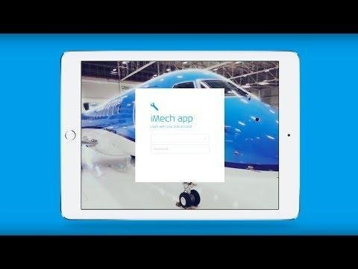

Aviation Industry Accolades & Testimonials
PETER BAUMGARTNER
CEO Etihad Airways
On Digital Interactions & Partnerships
Hangar of the future - KLM iMech app
Etihad Airways partner airlines are working with the world’s leading technology companies – such as Sabre, IBM, Adobe, Cognizant, SAP and many others – to create a unified strategy to transform the way each airline interacts with guests at every touch-point of their journey.
LUTZ TILGNER
Managing Director
Digitization, Airport Operations
I really appreciate all your help in developing Apps for the Hamburg Airport Ground Handling. You’ve been developing the Android App for Pushback Vehicles, help improve the Airside Bus and Deicing App. Your work helps to improve the workflow of ground handling workers. I look forward to continuing to work together.

Slide 62
Why Partner with Cognizant?
Be a Trusted Partner with strong Exec. Sponsorship
Cognizant Canada Head- Doug M
Deep Airline relationships across the globe
01
Enable great customer journeys
Strategic foresight powers customer experience transformation
Customer and Employee Journeys mapped across Org
02
02
Ensuring Safe and Reliable Operations
Operational metrics with defined SLAs
Business Outcomes mapped to technology enablers
03
Foster Innovation and Collaboration
Managed Innovation framework to drive business ideas
Leverage Partner Ecosystem to bring in best of breed solutions
04

Slide 63
Enabling Client Transformations

Slide 64

Largest Food Retailer in Canada – Cognitive Operations through Automation
20% Automation Efficiency
IVR, Self-Service Portal
42% Cumulative Automation Achieved
NOC Operations
Legacy Modernization & TEMS
33% Additional Automation
Data Center Consolidation
2020 Goal
100% Chat Bot Adoption
With 0 Voice Support
2013
2019
2017
2018
2020
2015
SCALE & FLEXIBILITY
DELIVERING TO OUTCOMES
SKIN IN THE GAME
A GLOBAL DIGITAL PARTNER
Industry-Leading Business Transformation
Service Desk Support
Monitoring Scope
Renewables Generation Sites – Application Support
Enterprise-wide
Access & Password related Issues
Intelligent
Automation
$24 M
operational
savings in 3 year duration
0
Zero outage during last peak support
60%
Incident reduction
75%
Reduction in call time
40%
Alerts resolved through automation
90% Reduction in release & time to market through effective DevOps
78%
First call resolution
73%
Password related tickets through IVR
~60%
Automation overall projected

Slide 65
Etihad – Digital Transformation Partner and System Integrator
Staff Augmentation to Managed Services
Digital Factory Operational
Recognized as
Digital Partner
Expanded to Systems Integrator Status
Pilot Agile, Architecture Transformation
2018 & Onwards
2014 -15
2016
2017
QA, Certification of Sabre Community Release
Multiple Capex projects in commercial T&I
Selected as digital transformation partner
Flight operations engagements
Vision for digital guest Innovation
European Partner Airline: Digital transformation from legacy system to SABRE DC
Established Digital PMO, Digital Architecture Office & Digital Concept Team
Commencement of digital builds for loyalty, engineering, etc.
Completion of marketing tools adoption strategy, design, roadmap
Incremental transformation of additional digital properties
European partner airline: Rollout of campaign solution
Go-live of Etihad Guest, Cargo and Hala travel management on the new digital platform
Completion of the discovery exercise for guest self-service programme for Midfield Airport
Commencement of DTI-online self-service hub
Commencement of the new Midfield Airport operations integration project
Commencement of the micro-services as a factory as well as the DevOps model
SCALE & FLEXIBILITY
DELIVERING TO OUTCOMES
SKIN IN THE GAME
A GLOBAL DIGITAL PARTNER
SCALE & FLEXIBILITY
DELIVERING TO OUTCOMES
SKIN IN THE GAME
A GLOBAL DIGITAL PARTNER
Partnered in Scaling Business
Delivery Excellence
Empowering Support
Speed to Market
Continuous Improvement
Enhanced User Experience
5%
Annual increase in global customer base
20%
Yearly growth in Etihad guest membership
10
Projects Delivered
350
Test Deployments
34
Production Deployments
60%
Reduction in support queue backlog
75%
Reduction in time-to-market
40
Continual service improvements delivered
10%
Increase in unique page views post go-live

Slide 66



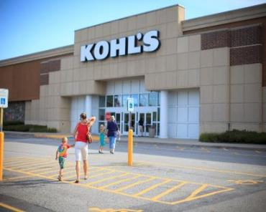
Kohl’s – End to end Managed Services & Application Support
Systems that
DO
Systems that THINK
Systems that
LEARN & INTERACT
Next-Gen Services
2018-19
2012-17
2017-18
Automated self-service password reset developed on Avaya CMS and hosted in Cognizant data center
Seamless integration with existing IT landscape
End-to-end automation themes like Linux patching & server decommission
AI-led operations framework with Machine Learning
Enables collaborative problem solving
Has built-in chat engine to enable human-machine interaction
NextGen Contact Center Solutions
Partnering in DIGITAL Transformation
SCALE & FLEXIBILITY
DELIVERING TO OUTCOMES
SKIN IN THE GAME
A GLOBAL DIGITAL PARTNER
Partnered in Industry Leading Business Transformation
Service Desk Support
Monitoring Scope
Renewables Generation Sites – Application Support
Enterprise-Wide
Access & Password related Issues
Intelligent Automation
$14.5M
Operational
Savings
0
Zero Outage during Peak Support
60%
Incident Reduction
75%
Reduction in
Call Time
40%
Savings in Monitoring Efforts & Health Checks
70%
Reduction in Patching Time
80%
First Call Resolution
73%
Password Related Tickets through IVR
~45%
Automation Overall Projected

Slide 67
THANK YOU
Cognizant (Nasdaq-100: CTSH) is one of the world's leading professional services companies, transforming clients' business, operating and technology models for the digital era. Our unique industry-based, consultative approach helps clients envision, build and run more innovative and efficient businesses. Headquartered in the U.S., Cognizant is ranked 195 on the Fortune 500 and is consistently listed among the most admired companies in the world. Learn how Cognizant helps clients lead with digital at www.cognizant.com or follow us @Cognizant.
www.cognizant.com

Slide 68
Appendix

Slide 69
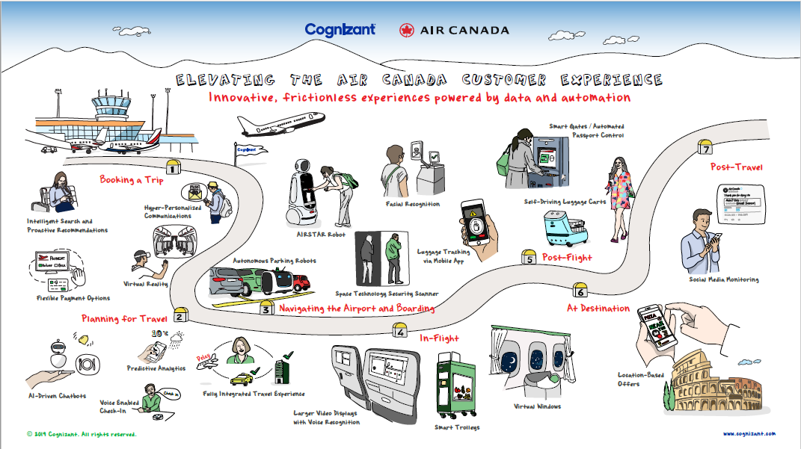

Slide 70
